Slide 1
Review : Progressive Layered Extraction(PLE)
A Novel Multi-Task Learning (MTL) Model for Personalized Recommendations
Kaist GSDS Master’s Degree
20224314
Hyeongu Kang
Notes:
Hello, I’m Hyun-gu Kang of GSDS. I will present Progressive Layered Extraction paper review.

Slide 2
CONTENTS
1. Summary of Paper
2. Pros & Cons
3. Research Idea
Define problem
Related work / prior method
Solving method
Experiment
Result
Strong point
Weak point
Notes:
The order of presentation is as follows
1. Summary of Paper
2. Pros & Cons of Paper
3. Research Idea

Slide 3
1. Summary of Paper
Define Problem
Related work / prior method
Solving Method
Experiment
Result
Notes:
In the ‘Summary of Paper’, I will brief paper in five steps as follows.

Slide 4
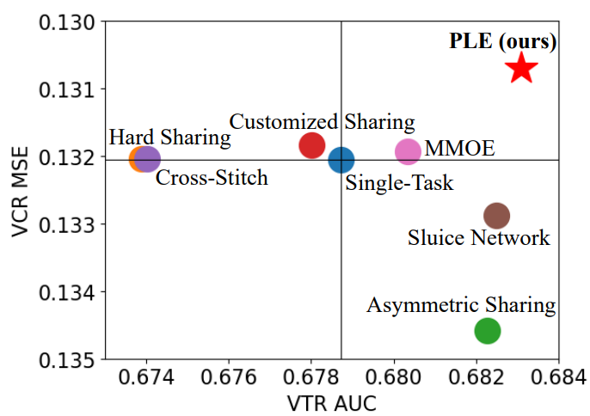
Define Problem
1. Summary
1) Negative Transfer
<Customized Gate Control(CGC) Model>
Common phenomenon in MTL for loosely correlated tasks
- Performance deterioration in MTL
2) Seesaw Phenomenon
Occur when tasks are 1) strongly correlated, 2) sample dependent
Improvement of one task leads to
performance deterioration of other tasks
Negative Transfer and Seesaw Phenomenon are
common problem of MTL. Solving both is important.
Notes:
In this paper, it define two problems: Negative Transfer and Seesaw Phenomenon
Negative Transfer means that the performance will deteriorate if the correlation between each task is low, or rather if there is a conflict.
There are several ways to resolve Negative Transfer.
I'll explain the details later.
Seesaw Phenomenon, which, is defined first in this paper
This Phenomenon happens when the correlation between tasks is high and dependent each other
It means that a performance improvement in a particular task lead to the performance of the other tasks is deteriorating.
You can see that most methodologies have a seesaw phenomenon, as shown in the figure attached next to them.
Since Negative Transfer and Seesaw Phenomenon are common problems with MTL, and it's important to solve them.

Slide 5
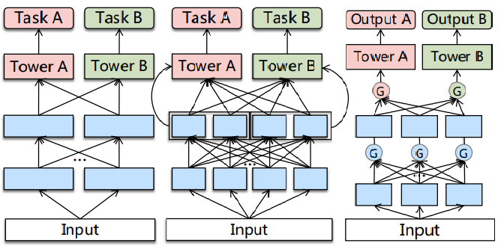
Related word / Prior method
1. Summary
<Cross-Stitch Network>
<Sluice Network>
<ML-MMOE>
Several methods of prior work of MTL
try to solve negative transfer, but neglect the seesaw Phenomenon
Notes:
There are several methods such as Cross-stitch network, Slice network, and MMOE to address Negative Transfer.
Among them, MMOE was considered the SOTA method at the time.
However, each methods not consider about Seesaw Penomenon.

Slide 6
Related word / Prior method
1. Summary
<Cross-Stitch Network>
<Sluice Network>
<ML-MMOE>
<Property>
Learn weights of linear combinations to fuse representations from different tasks
→ Try to deal tasks conflict
But, representations are combined with the same static weights for all samples
→ Can’t address Seesaw Phenomenon
* Adaptive combinations of tasks is needed
By reviewing Cross-Stitch Network and Sluice Network,
we can check that adaptive combinations of tasks is needed
Notes:
we can find improvement point by looking at the characteristics and limitations of each methodology.
First of all, for Cross-Stitch Network and Loose Network,
They learned the weights from different Tasks by linear combinations of the representation.
However, they have fixed/equal weights for all samples
It did not derive more precise results, nor did it address Seesaw Phenomenon.
Therefore, we can see that Adaptive combinations of tasks are required.

Slide 7
Related word / Prior method
1. Summary
<Cross-Stitch Network>
<Sluice Network>
<ML-MMOE>
<Property>
- Apply gate networks to obtain different fuse
weight of task difference among bottom expert
→ 1) Deal with negative transfer
and 2) optimize multiple objectives
- But MMOE not consider task correlation
→ Limit the performance of joint optimization
* There is no Task-specific / Task-shared concept
By reviewing ML-MMOE Model, Gate network is effective to fuse different tasks but we also consider task specific / shared concept
Notes:
In the case of the SOTA method, MMOE, the difference between each task was reconciled using the Gate Network.
This allows for 1) Deal with negative transfer, 2) Optimize multiple objects by adjusting the differences between tasks well.
However, MMOE has the disadvantage of not considering the relationship between tasks.
This limited the performance of the model and did not address the seesaw Phenomenon.
As a result, we can see that the Gate network is useful, but additional Tasks specific / task-shared concept needs to be introduced.

Slide 8
Related word / Prior method
1. Summary
Trial exist to apply Task specific/shared concept and find good network structure
1) MTAN
2) SNR framework
- First apply task-specific attention network
to fuse shared features selectively
- But different tasks still share the same
representation before fusion in attention
→ Tasks are mixed before consider
task specific / shared property
Control connections between sub-networks by binary random variables
Apply NAS to search for the optimal structure
→ Designed with certain simplified
assumptions and are not generalized enough
There are good trial in MTL, but all of prior methods are
not enough to become proper and generalized
Notes:
This is not the first time that have divided the Task-Specific/Task-common concepts to reflect the relationship between Tasks
MTAN used Task-specific / Task-common notion first.
However, before going through the Attention Network, it shared representations among different tasks, it creates an environment where interference between each characteristic could occur.
Through the case of MTAN, we can see that it is important to find a good network structure.
In the case of SNR Framework, we tried to find the optimal structure, such as applying NAS.
But it assume that "The routing network selections no more than one function block for each task in each depth",
which reduced the model's expressiveness.
In Summary, previous models did not distinguish Task-Specific/Task-common concepts well on the network, or were not sufficient to generalize.

Slide 9
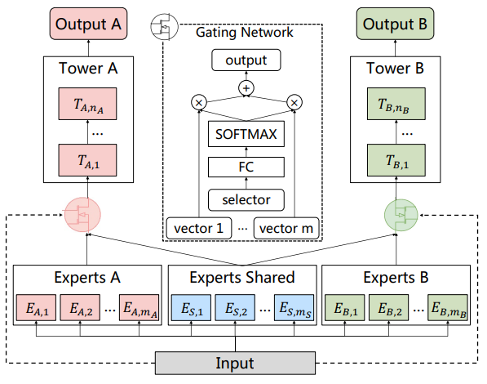
Solving Method – CGC
1. Summary
<Customized Gate Control>
<Customized Gate Control(CGC) Model>
Bottom : Shared & Specific expert modules
Gate : Fuse representation of specific experts and shared experts dynamically
Tower : Absorb knowledge from shared and specific expert through gate
CGC achieves more flexible balance between tasks and better deals with task conflicts and sample-dependent correlation
Notes:
Therefore, PLE solves the problem by dividing it into three main steps.
First, Customized Gate Control. I'll call it CGC.
The CGC is largely composed of Bottom/Gate/Tower.
The bottom, which is a blue area, consists of shared experts, which are responsible for common patterns between Specific Experts and Tasks, respectively.
Afterwards, each specific expert and shared expert are dynamically combined through gate in Green.
It is important to note that the connection between different Task-specific experts has been disconnected.
Finally, the tower receives the information of the specific expert and the shared expert through the gate and produces the results which is related to each task-specific.
This allows the CGC to balance tasks and to handle Task conflict and sample-dependent correlation.

Slide 10
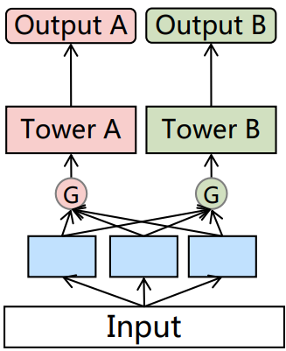
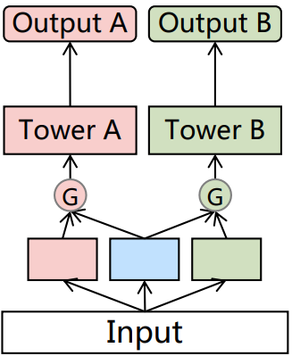
Solving Method – CGC
1. Summary
<MMOE vs CGC>
<MMOE Model>
<CGC Model>
There are two differences
1. Routing Strategy
MMOE connect all of experts
CGC connect each specific expert and shared expert
2. Bottom ingredient
MMOE only use task-specific expert
CGC use task-shared / specific experts
Specific expert 1
Specific expert 2
Specific expert 3
Specific expert 1
Shared expert
Specific expert 2
The difference of Routing Strategy and Bottom Ingredients allows CGC to well consider the difference and relationship among Tasks.
Notes:
Let's talk about the difference between MMOE and CGC.
There are two differences: Routing Strategy and Bottom Ingredients.
The MMOE considers the relationship of all experts, but the CGC considers only each Specific Expert and Shared Expert.
At this time, the MMOE's routing strategy seems to be a generalization of the CGC's routing strategy, but the result is not.
I'll talk about this later.
MMOE also considers the Specific Expert in Bottom, but CGC additionally considers the Shared Expert.
The difference between Routing Strategy and Bottom Ingressives allows CGC to consider the difference and relationship between Tasks.

Slide 11
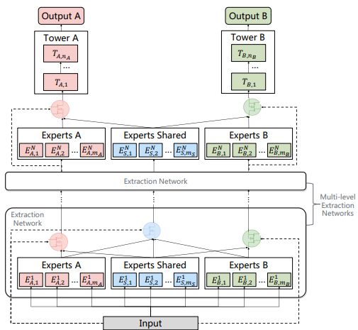
Solving Method – PLE
1. Summary
<Progressive Layered Extraction Model>
<Progressive Layered Extraction>
1. Hierarchy structure of information
- Extract higher-level shared information
- Gating network in higher-level take the fusion
results of gates in lower-level
2. Progressive separation routing
- Remove connection with other task-specific
- Consider high-level shared semantic representation
PLE shape out deeper semantic representations gradually with dividing whether the intermediate representations is shared or task-specific
Notes:
Second, it utilize Progressive Layered Extraction.
I will refer to it as a PLE.
PLE extract higher-order shared information
And model dynamically combine low-dimensional and high-dimensional information through Gate.
The network is then configured to remove the connection between each task-specific, so that higher-dimensional semantic presentation is gradually reflected.

Slide 12
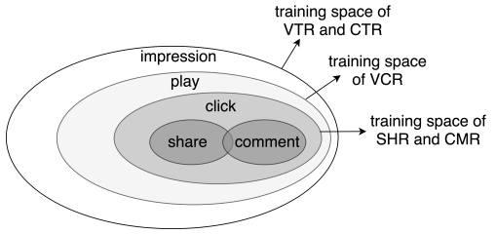
Solving Method – Joint Loss optimization
1. Summary
<Joint Loss Optimization for MTL>
1. Joint Representation
- Solve problem of heterogeneous samples space
ex) Due to sequential users action, share & comment
action are considered as heterogeneous
- Consider the union of sample space to train jointly
2. Introducing dynamic weight
Performance of MTL is sensitive to weight
Consider of weight tasks fluctuated with time
<Training Space of Different tasks>
By applying Joint Representation and dynamic weight, solve several issue in making joint optimization of MTL in practice
Notes:
Finally, we introduce Joint Loss Optimization.
Some samples should be considered as the same sample space, but it may be considered as a different sample due to the user's continuous behavior.
Therefore, in this case, combine the sample spaces so that they can learn together.
In addition, considering that MTL's performance is sensitive to weights,
Sets up the weight to change dynamically

Slide 13
Experiment
1. Summary
Data
Industrial dataset from Tencent. 46,926 mil users / 2,682 mil video, 0.996 billion samples in Dataset
Public Dataset : Synthetic Data, Census-income Dataset, Ali-CCP Dataset
Baseline model
Single model : Normal, Symmetric, Customized sharing, Cross-stitch, Sluice Network, MMOE
Multitask model : ML-MMOE
Test Case
1) Degree of Correlation between Variables(Strong or Loose)
2) Single-task model on Online A/B test
3) Single / Multi tasks
4) Expert Utilization Analysis between MMOE & PLE
Estimation
Calculate AUC & MSE of each Indicator(main on VCR, VRT) + MTL Gain
* MTL Gain : Quantitively evaluate the benefit of Multi-task learning over the single-task model
Notes:
, paper check the performance of the PLE. Based on the methods described above
Details of the Experiment are as follows:

Slide 14
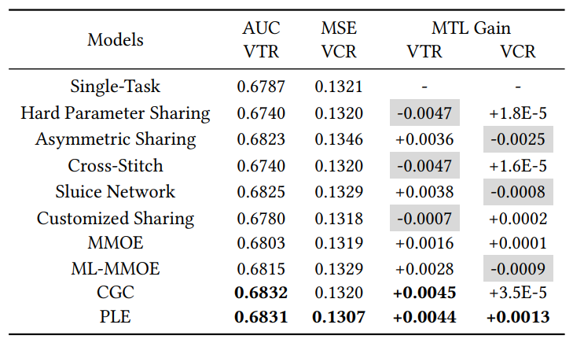
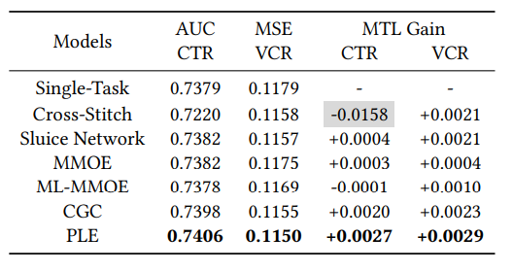
Result
1. Summary
<Strong Correlation between Variable>
<Loose Correlation between Variable>
identify seesaw phenomenon exist
PLE’s performance is really close to SOTA-method or over-performance
Even correlation between variables is loose, PLE overscore SOTA-MTL method
Regardless relation between variable is strong or loose,
PLE overscore for most aspect of test then SOTA-MTL method
Notes:
Through the yellow area, we can see that Seesaw phenomenon really exists in the Strong correlation situation.
By Comparing PLE with several MTL methods, we can Check that
PLE solves the Seesaw phenomenon
Even in Loose Correlation situations where there is little seesaw phenomenon, most of cases are performed at SOTA’s achievements

Slide 15
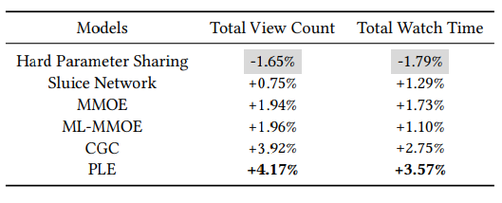
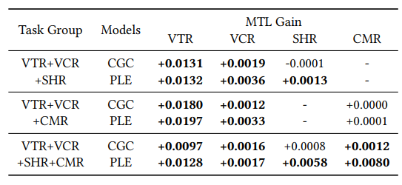
Result
1. Summary
<Performance on Online A/B test>
<MTL gain of CGC & PLE on Multi Tasks>
Shows improvement of MTL models over the single-task model on Online total view count & watch time
CGC & PLE show the benefits of promoting task cooperation
PLE outperforms CGC in all cases
PLE delivers the best performance in real-world online applications
And it also proved the positive influence of Multi-task learning.
Notes:
PLE also achieved the best results in the actual Online A/B test
by improving Total View Count and Total Watch Time by 4.17% and 3.57%, respectively.
Also, in all cases of combination of variable, when you increase the combination of Task Groups to 3 and 4,
You can see that CGC and PLE always bring positive results.

Slide 16
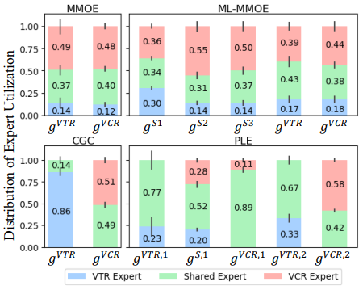
Result
1. Summary
<Expert Utilization in Gate-Based Models>
MMOE’s routing is not Generalization of CGC’s
Distribution between MMOE & ML-MMOE is similar
But distribution of CGC& PLE is significantly different.
→ CGC’s structure helps achieve better performance & MMOE hard to converge CGC without prior knowledge
Higher-level deeper representation is Valuable
PLE performs better than CGC
Shared expert in PLE have larger distribution
→ Show that high-level deeper representation is valuable
Expert Utilization show that PLE is good model than ML-MMOE & Higher-level deeper representation is Valuable in MTL
Notes:
Furthermore, we can find out insights from the Expert Utilization of the four models MMOE, ML-MMOE, CGC, and PLE.
In earlier, I said that MMOE's Routing Strategy seems to be generalized compared to CGC's, which takes into account all Bottom's Ingredients.
However, in the relationship between MMOE and CGC, and ML-MMOE and PLE, the percentage of use of each expert is very different
And through the fact that CGC and PLE perform better than MMOE and ML-MMOE,
It can be seen that the routing strategy of MMOE does not converge to the strategy of CGC and is not optimal.
Also, in the relationship between CGC and PLE,
The proportion of shared experts in PLE is relatively very high
And through the fact that PLE's performance is better than CGC,
We can see that progressive separation and high-level deeper presentation help improve performance.

Slide 17
2. Pros & Cons
Strong point
Weak point
Notes:
The following are the Pros & Cons of Paper.

Slide 18
Strong point
2. Pros & Cons
1. Novel Idea(Contribution)
2. Good Motivation
3. Reproducible
4. Convincing Results
Notes:
I will tell you strong point based on the following four criteria.

Slide 19
Novel Idea(Contribution)
2. Pros & Cons
1. Specify the problem “Seesaw Phenomenon” and why this happen.
- Improvement of one task often leads to performance degeneration of the other task
- “Seesaw Phenomenon” occurs when tasks are strongly correlated and especially sample dependent
2. Solving “seesaw Phenomenon” & “Negative transfer” and achieve SOTA’s grade
Propose CGC and Information routing strategy
Propose Gating Network in Higher-level extraction Network
3. Show that considering all of relation among tasks not guarantee optimal result
- MMOE’s gate connect all of tasks but, PLE only connect each specific tasks & shared tasks
- PLE overscore MMOE in most case.
- There is significant difference between distribution of PLE and ML-MMOE’s expert Utilization
Notes:
First, I chose three point in the aspect of the Novel Idea perspective.
First, paper define Seesaw phenomenon and then specify why this is happening.
This provided a basic reason for why the PLE method could further improve performance, unlike previous methods
It's also make to prepare in advance for situation where Seesaw phenomenon could happen
Secondly, PLE solve both of Seesaw Phenomenon and Negative transfer
Especially, the concept of applying appropriate routing strategy for distinguishing between shared and specific experts is
seems to be widely applicable to other MTL methodologies.
Finally, I explained through the comparison between MMOE and CGC
I already explain that by comparing MMOE & CGC
This is good example to check importance of network structure

Slide 20
Good to Motivation
2. Pros & Cons
1. Solving common problem of MTL : “Negative transfer” & “Seesaw Phenomenon”
- Since ‘Negative transfer’ frequently occurs in loosely correlated tasks.
- On the other side, ‘Seesaw Phenomenon’ frequently occurs in strongly correlated tasks, especially sample-dependent situation
→ In most case of MTL, one of problem easily occurs
2. 0.1% improve of AUC/MSE contributes significant improvement to online metric
VCR’s MSE decrease 1.1% & VTR’s AUC increase 0.7%
It result in increase of 4.17% Total view count & 3.57% of Total watch time
in single-task model on Online A/B test
Notes:
The PLE is largely motivated by two parts.
First, Negative transfer and seesaw Phenomenon are common problems in MTL.
Since, the occurrence conditions of Negative Transfer and Seesaw Phenomenon are contradictory, so one of them can be easily encountered in most MTL problems.
And PLE is a good way to solve both problems.
In addition, improving the AUC/MSE by even 0.1% for each task will lead to significant improvements in online metric.
Paper also reduced VCR's MSE by 1.1% and increased VTR's AUC by 0.7%.
This led to a significant improvement in the Online A/B test: a 4.17% increase in total view count and a 3.57% increase in total watch time.

Slide 21
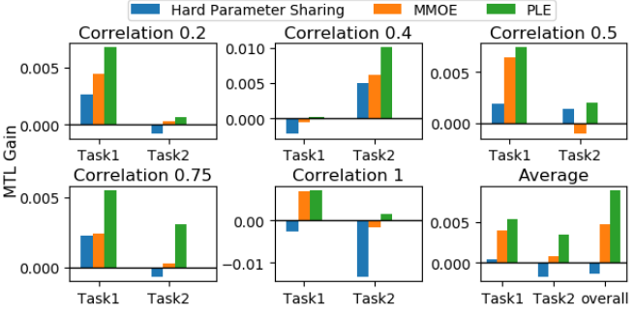
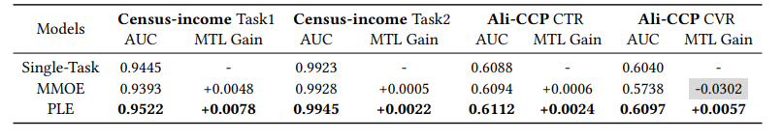
Reproducible
2. Pros & Cons
1. The PLE method is also effective in Public Data.
- 1.4 mil samples of Synthetic Data are used
- Prove that PLE consistently performs best
for both tasks across different correlations
- Achieves 82.7% increase in MTL gain
over MMOE on average
- PLE overscore MMOE in public data of Census-income Dataset and Ali-CCP Dataset
<MTL gain on Synthetic Data>
<Experiment Results on Census-income and Ali-CCP Dataset>
Notes:
PLE also has strength in terms of reproducible.
When validated with 1.4 mil Synthetic Data, every moment it performed better than MMOE.
Public data, such as Census-income Dataset and Ali-CCP Dataset, also yielded better results than MMOE.

Slide 22

Convincing Results
2. Pros & Cons
1. The PLE method ensured the best performance in most cases with large data
- Using 1 billion samples of Tencent Video recommendation dataset
Show that there is 'seesaw phenomenon' and prove that PLE can solve this problem.
Regardless of the correlation degree between tasks, it brought the best performance.
Increase Total view count and Total Watch Time by 4.17% and 3.57% respectively in the online A/B test.
<Strong Correlation between Variable>
<Loose Correlation between Variable>
<Performance on Online A/B test>
Notes:
And PLE provides convincing Results
Using 1bil of data from Tencent Video, paper demonstrate that the performance of PLE is not limited to certain minority situations.
Also in the aspect of metric, you can observe Seesaw Phenomenon in Strong Correlation situations
Considering that the PLE performance resulted in significant results in the online A/B test,
The performance of the PLE is easily convinced.

Slide 23
Weak point
2. Pros & Cons
1. Additional considerations arising from the introduction of shared experts
1) Calculation volume increase because of updating shared expert’s parameter
2) Calculation volume increase due to parameter increase
3) Selection problem about appropriate shared expert
2. Lack of explanation
1) Does really 0.1% increase of AUC / MSE statistically meaningful?
2) Why use different metric(AUC/MSE) in figure 3?
Notes:
On the other hand, I think this paper has a Weak point in two main aspects.
The first is the additional considerations arising from the introduction of shared experts
The second is the lack of explanation for some of the descriptions.

Slide 24
Weak point
2. Pros & Cons
1. Additional considerations arising from the introduction of shared experts
1) Calculation volume increase because of updating shared expert’s parameter
- Parameters of Shared experts are affected by all tasks
while parameters of task-specific expert are only affected by the corresponding specific task
2) Calculation volume increase proportionally with the number of tasks
- Size of the network parameters grows proportionally with respect to the total number of tasks
- When there are n independent tasks, the number of cases of shared experts become very large.
Even if shared experts only consider relationship between each two tasks,
the number of shared experts required is n(n-1)/2.
3) Selection problem about appropriate shared expert
- Human resource is needed to select appropriate shared experts
Notes:
PLE introduces additional Shared experts to distinguish Task-specific / Task-shared concepts.
At this time, the Shared expert used common fusion operations such as concatenation, sum-pooling, and average-pooling to connect different tasks
The parameters of the shared expert must be updated together whenever the parameters of any task are updated.
This means an increase in the amount of computation.
~~~
At this point, even if we only consider the relationship for each pair of tasks, is similar to n^2.
~~~
As mentioned earlier, considering the relationship between the tasks increases the computation significantly.
However, creating a shared expert that covers all tasks will narrow your consideration.
Eventually, Human resource is needed to choose point that balance between calculation and expressiveness heuristically.

Slide 25
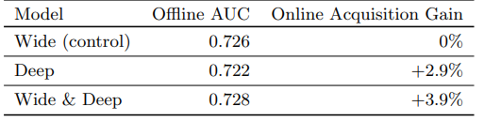
Weak point
2. Pros & Cons
2. Lack of explanation
1) Does really 0.1% increase of AUC / MSE statistically meaningful?
- Paper only mention “It is worth noting that 0.1% increase of AUC or MSE contributes significant improvement to online metrics in our system, which is also mentioned in [4, 6, 14].”
- [14] : “This is a significant improvement for industrial applications where 0.1% AUC gain is remarkable.”
- [6] : use as a reason of [4] such as,
“Wide & Deep improves AUC by 0.275% (offline) and the improvement of online CTR is 3.9%.”
- But when check [4] Cheng et al,
[6] only describes the transition from
the base model(Wide) to the Wide & Deep model,
but does not explain the case of the Deep model
in which the AUC has decreased but the
Online Acquisition Gain has increased.
2) Why use different metric(AUC/MSE) in figure 3?
<Offline & Online metrics of different models>
* Figure from [4] Cheng et al
Notes:
There was also a lack of explanation in some of the descriptions in Paper.
~~~~
~~~~.
In other words, it can be seen that the author intuitively argues that the increase of 0.1% is significant without any supporting evidence.
In Addition, Figure 3 does not provide a reason for why different metrics, AUC and MSE are used, to describe Seesaw phenomenon.

Slide 26
3. Research Idea
Notes:
Finally, Research Idea.

Slide 27
3. Research Idea
1.Reduce the amount of calculation
1) Introducing Dropout
2) Check applicability of parallel and distributed MTL
3) Dimension reduction about domain of tasks
2. Expand to multi-domain learning
3. Combination of multi view/domain/tasks
4. More deep hierarchy PLE Model
Notes:
I think about four research Idea from PLE
The first is to solve the computation problem of the PLE.
As an example, I want to apply Dropout to the PLE model.
The number of parameters of PLE are increased in proportion to the number of tasks
By applying Dropout to fix the number of tasks you consider at once, we can not only calculate efficiently but also provide robustness for the model.
Especially if we reduce the number of parameters through Dropout
we can apply the Parallel and distributed MTL method.
Additionally, By using the concept of dimension reduction in tasks,
Such as important tasks can be selected between tasks or combined into new tasks, we can improve the amount of computation reduction.
Secondly, ~~~~~.
For Multi tasks, it is a methodology that combines different tasks for the same area.
By changing this, like measuring VTR's AUC for different content,
By giving the same tasks to different areas, we can once again drive performance improvement.
If you could combine multi-learning methods like multi-view, multi-domain, and multi-task,
We can deliver better performance.
Finally, structure more deer hierarchy PLE model
Based on the PLE layer, paper have divided the model into lower-level and higher-level.
If we deepen the layer and give multiple layers of PLE,
I expect that model can bring out higher-level deeper presentation.

Slide 28
Q n A
Notes:
Thank you for listening
If you have any questions, please feel free to ask.

